Slide 1






Foundations of
Quantum Information Science (QIS 101)
Dave Biersach
Brookhaven National Laboratory
dbiersach@bnl.gov
Session 12
Classical
Wave Equations

Slide 2
Session 12 – Goals
Review Newton's Binomial Theorem
Extract Square Roots using Newton's Series
Compare the Rate of Convergence of Binomial Expansions
Study Newton's Derivation of the Sine Power Series
Derive and Visualize Taylor Series for Fractional Roots
Review the key parts of a sinusoidal transverse wave
Consider the kinematics of a travelling wave, as it relates to amplitude, wavelength, and frequency

Slide 3
Session 12 – Goals
Appreciate the affect of sampling rate on aliasing
Understand the Nyquist Sampling Theorem
Derive the Classical Wave Equation
Use Finite Differences for Partial Differential Equations
Simulate Mechanical Waves on a String
Calculate the Electromagnetic Field Wave Phase Speed

Slide 4
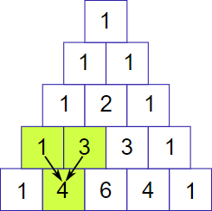
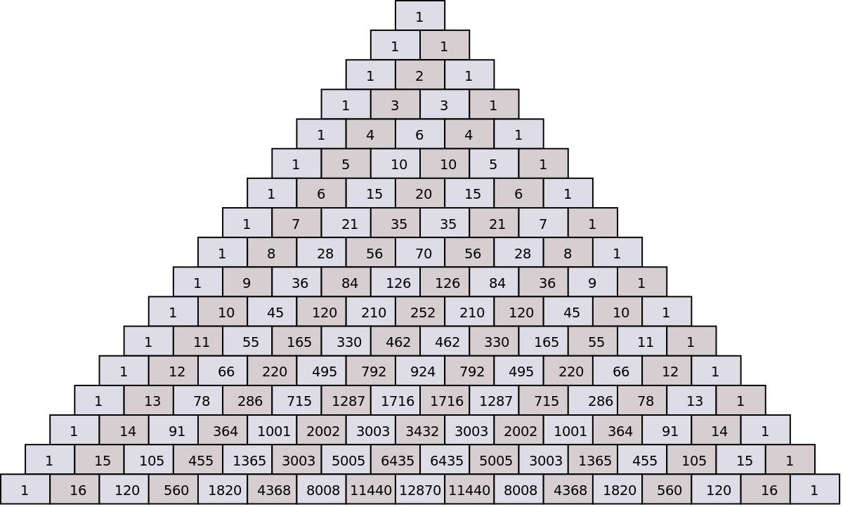
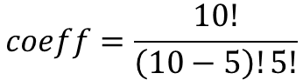
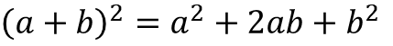
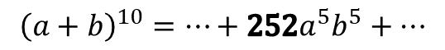
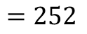
Pascal's Triangle & Combinations
$${\left(a+b\right)}^{2}=a^{2}+2ab+b^{2}$$
$${\left(a+b\right)}^{3}=a^{3}+3a^{2}b+3ab^{2}+b^{3}$$
$${\left(a+b\right)}^{4}=a^{4}+4a^{3}b+6a^{2}b^{2}+4ab^{3}+b^{4}$$
Row 0
Column 0
$$coeff=\frac{10!}{\left(10−5\right)!5!}$$
5
$$=252$$
10
$${\left(a+b\right)}^{10}=⋯+252a^{5}b^{5}+⋯$$

Slide 5
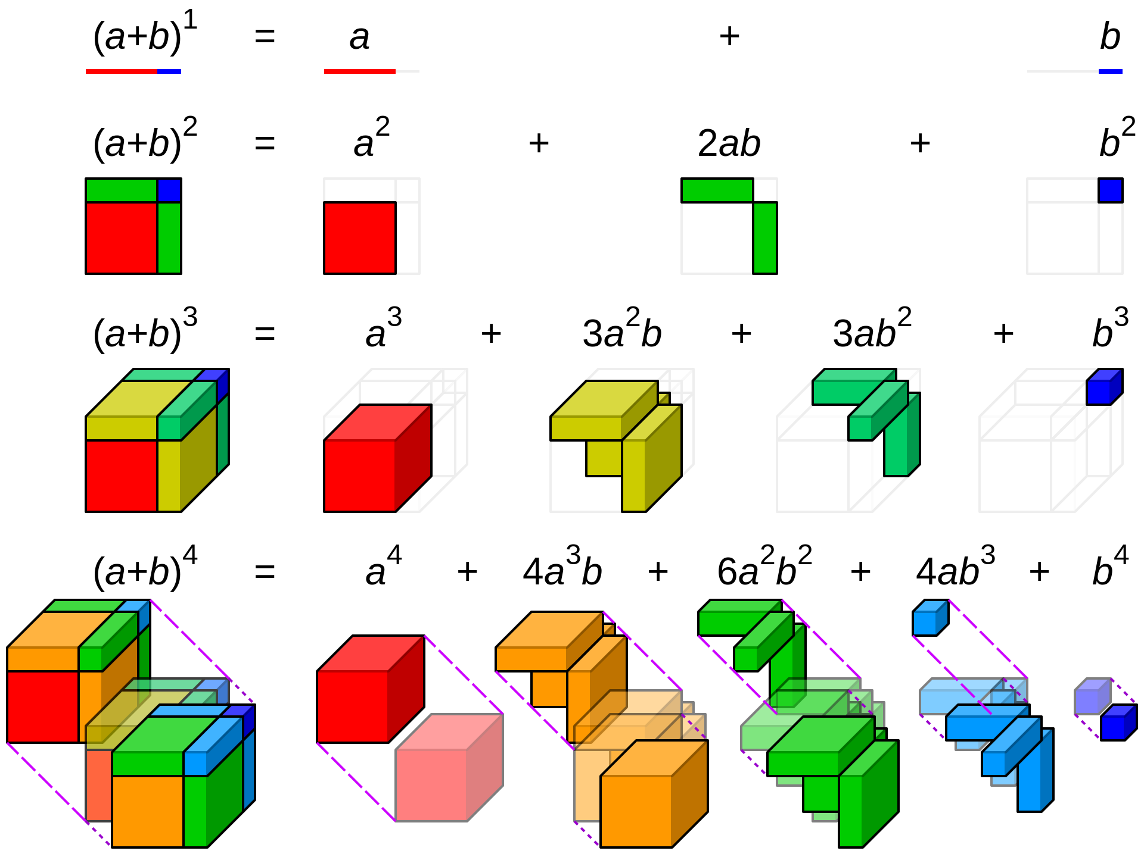
Polynomial Expansion

Slide 6
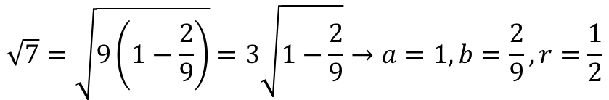
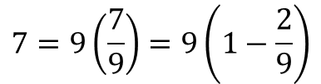
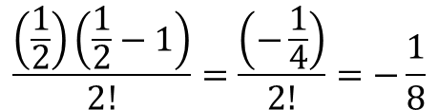
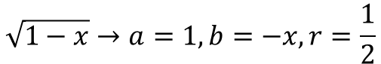

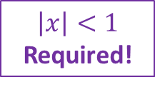
Newton's Generalized Binomial Theorem
$${\left(a+b\right)}^{r}=a^{r}+ra^{r−1}b+\frac{r(r−1)}{2!}a^{r−2}b^{2}+\frac{r(r−1)(r−2)}{3!}a^{r−3}b^{3}+⋯$$
$$\sqrt{1−x}→a=1,b=−x,r=\frac{1}{2}$$
$$\frac{\left(\frac{1}{2}\right)\left(\frac{1}{2}−1\right)}{2!}=\frac{\left(−\frac{1}{4}\right)}{2!}=−\frac{1}{8}$$
$$\sqrt{1−x}=1−\frac{1}{2}x−\frac{1}{8}x^{2}−\frac{1}{16}x^{3}−\frac{5}{128}x^{4}−\frac{7}{256}x^{5}+⋯$$
$$\left|x\right|<1$$
Required!
$$7=9\left(\frac{7}{9}\right)=9\left(1−\frac{2}{9}\right)$$
$$\sqrt{7}=?$$
$$\sqrt{7}=\sqrt{9\left(1−\frac{2}{9}\right)}=3\sqrt{1−\frac{2}{9}}→a=1,b=\frac{2}{9},r=\frac{1}{2}$$

Slide 7
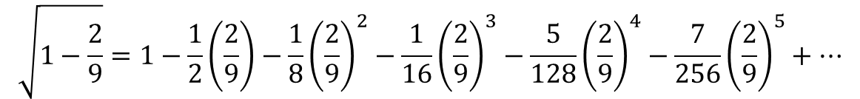
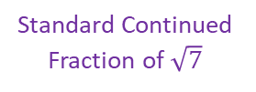
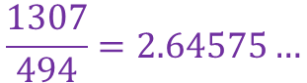
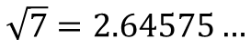
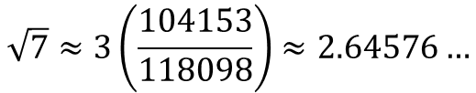
Newton's Generalized Binomial Theorem
$${\left(a+b\right)}^{r}=a^{r}+ra^{r−1}b+\frac{r(r−1)}{2!}a^{r−2}b^{2}+\frac{r(r−1)(r−2)}{3!}a^{r−3}b^{3}+⋯$$
$$\sqrt{1−x}→a=1,b=−x,r=\frac{1}{2}$$
$$\frac{\left(\frac{1}{2}\right)\left(\frac{1}{2}−1\right)}{2!}=\frac{\left(−\frac{1}{4}\right)}{2!}=−\frac{1}{8}$$
$$\sqrt{1−x}=1−\frac{1}{2}x−\frac{1}{8}x^{2}−\frac{1}{16}x^{3}−\frac{5}{128}x^{4}−\frac{7}{256}x^{5}+⋯$$
$$\left|x\right|<1$$
Required!
$$\sqrt{1−\frac{2}{9}}=1−\frac{1}{2}\left(\frac{2}{9}\right)−\frac{1}{8}{\left(\frac{2}{9}\right)}^{2}−\frac{1}{16}{\left(\frac{2}{9}\right)}^{3}−\frac{5}{128}{\left(\frac{2}{9}\right)}^{4}−\frac{7}{256}{\left(\frac{2}{9}\right)}^{5}+⋯$$
$$\sqrt{7}≈3\left(\frac{104153}{118098}\right)≈2.64576…$$
Standard Continued Fraction of $\sqrt{7}$
$$\sqrt{7}=2.64575…$$
$$\frac{1307}{494}=2.64575…$$

Slide 8
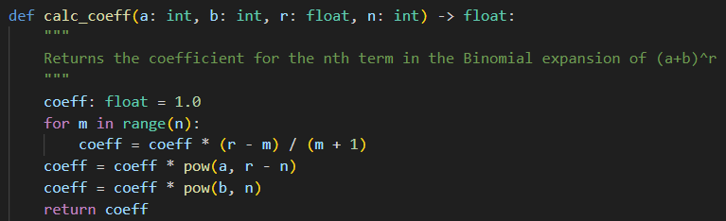
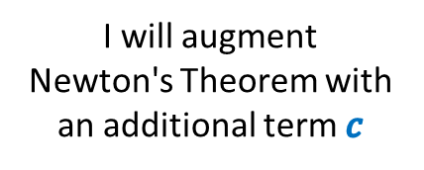
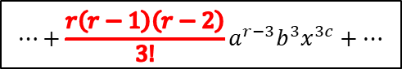
Open binomial_sqrt.py
①
②
③
$$⋯+\frac{r\left(r−1\right)\left(r−2\right)}{3!}a^{r−3}b^{3}x^{3c}+⋯$$
④
⑤
⑥
⑦
I will augment
Newton's Theorem with an additional term $c$
$${\left(a+bx^{c}\right)}^{r}=a^{r}+ra^{r−1}bx^{c}+\frac{r(r−1)}{2!}a^{r−2}b^{2}x^{2c}+\frac{r(r−1)(r−2)}{3!}a^{r−3}b^{3}x^{3c}+⋯$$

Slide 9
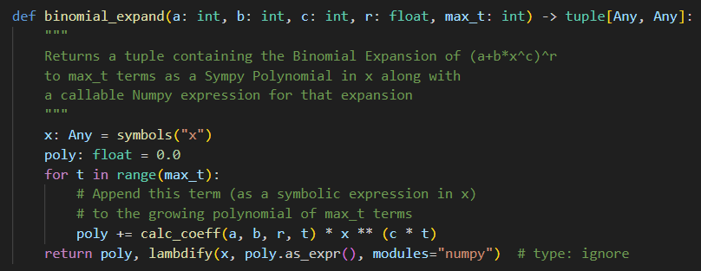
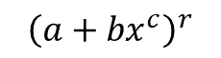
View binomial_sqrt.py
①
②
$${\left(a+{bx}^{c}\right)}^{r}$$
③
④
A SymPy Symbolic Expression
A NumPy Callable
Function
$${\left(a+bx^{c}\right)}^{r}=a^{r}+ra^{r−1}bx^{c}+\frac{r(r−1)}{2!}a^{r−2}b^{2}x^{2c}+\frac{r(r−1)(r−2)}{3!}a^{r−3}b^{3}x^{3c}+⋯$$

Slide 10
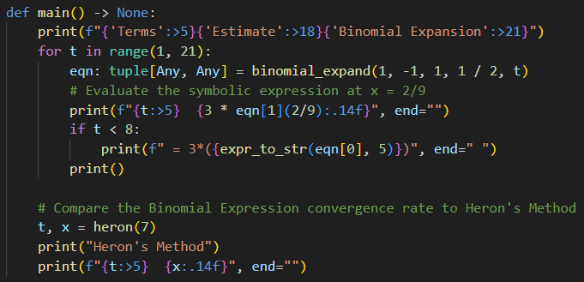
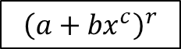
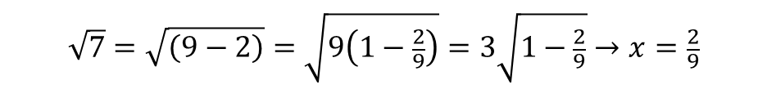
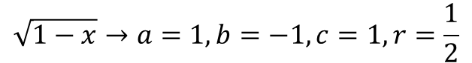
View binomial_sqrt.py
①
②
$${\left(a+{bx}^{c}\right)}^{r}$$
③
④
⑤
$$\sqrt{1−x}→a=1,b=−1,c=1,r=\frac{1}{2}$$
$$\sqrt{1−x}=1−\frac{1}{2}x−\frac{1}{8}x^{2}−\frac{1}{16}x^{3}−\frac{5}{128}x^{4}−\frac{7}{256}x^{5}+⋯$$
$$\sqrt{7}=\sqrt{\left(9−2\right)}=\sqrt{9\left(1−\frac{2}{9}\right)}=3\sqrt{1−\frac{2}{9}}→x=\frac{2}{9}$$
10

Slide 11
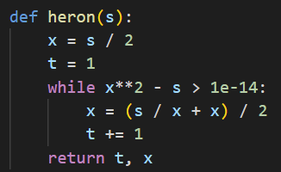
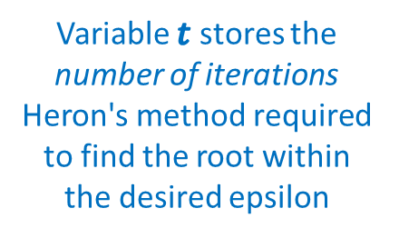
View binomial_sqrt.py
⑥
Variable $t$ stores the number of iterations Heron's method required to find the root within the desired epsilon

Slide 12
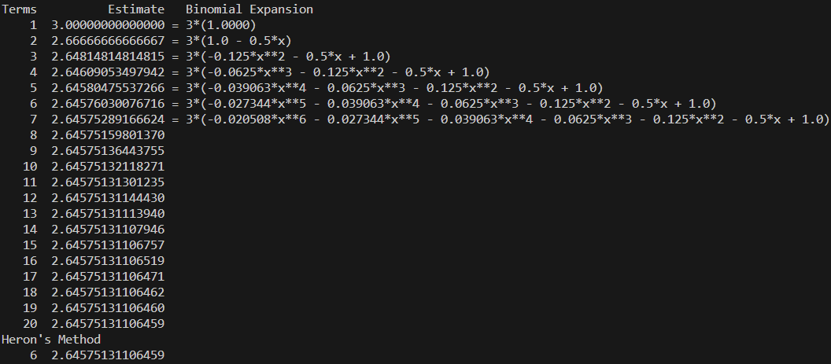
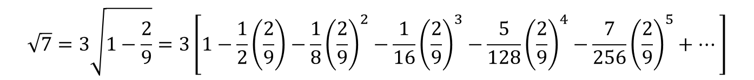
Run binomial_sqrt.py
①
$$\sqrt{1−x}=1−\frac{1}{2}x−\frac{1}{8}x^{2}−\frac{1}{16}x^{3}−\frac{5}{128}x^{4}−\frac{7}{256}x^{5}+⋯$$
②
③
Heron's Method Converges Much Faster!
$$\sqrt{7}=3\sqrt{1−\frac{2}{9}}=3\left[1−\frac{1}{2}\left(\frac{2}{9}\right)−\frac{1}{8}{\left(\frac{2}{9}\right)}^{2}−\frac{1}{16}{\left(\frac{2}{9}\right)}^{3}−\frac{5}{128}{\left(\frac{2}{9}\right)}^{4}−\frac{7}{256}{\left(\frac{2}{9}\right)}^{5}+⋯\right]$$

Slide 13
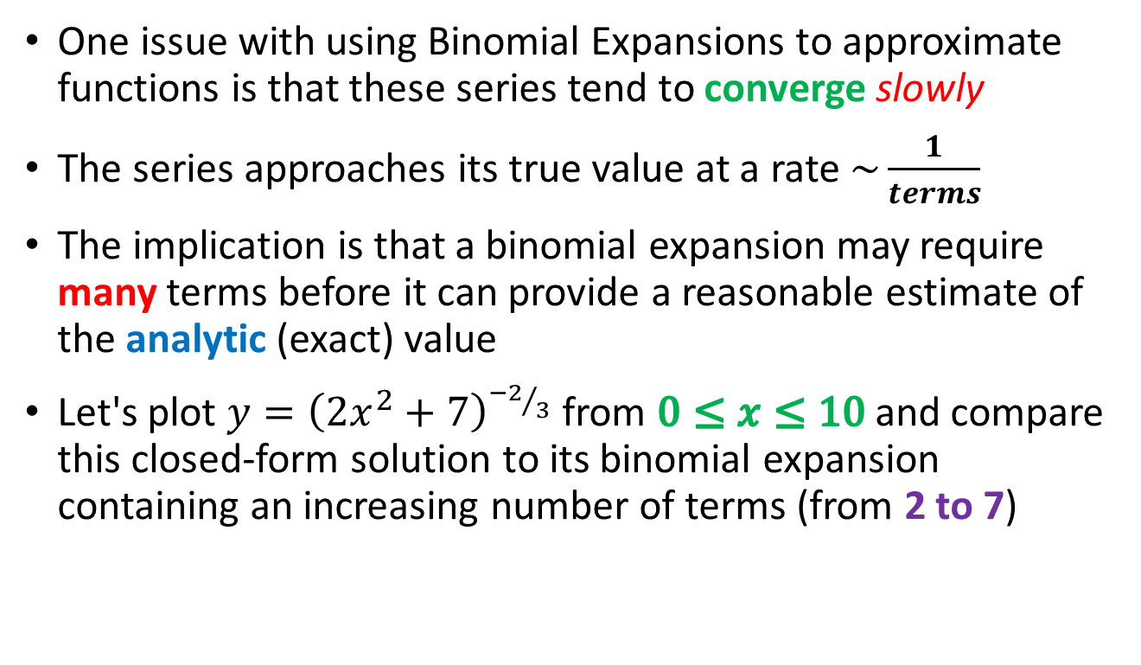
Convergence of Binomial Expansions
One issue with using Binomial Expansions to approximate functions is that these series tend to converge slowly
The series approaches its true value at a rate $\sim \frac{1}{terms}$
The implication is that a binomial expansion may require many terms before it can provide a reasonable estimate of the analytic (exact) value
Let's plot $y={\left(2x^{2}+7\right)}^{{−2}/3}$ from $0≤x≤10$and compare this closed-form solution to its binomial expansion containing an increasing number of terms (from 2 to 7)

Slide 14
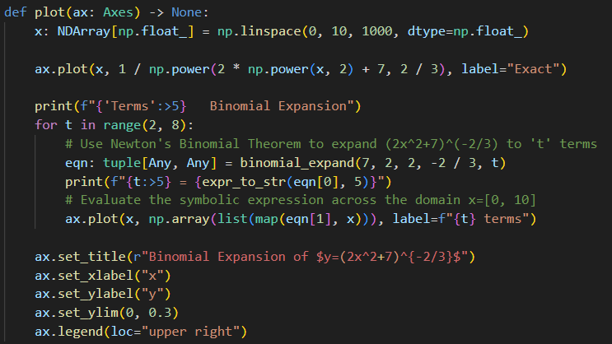
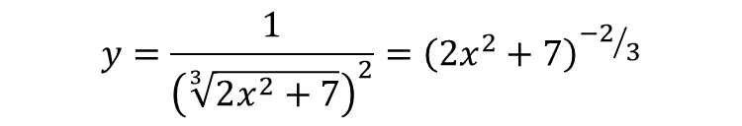
Open newton_binomial.py
①
②
③
④
⑤
⑥
⑦
$$y=\frac{1}{{\left(\sqrt[3]{2x^{2}+7}\right)}^{2}}={\left(2x^{2}+7\right)}^{{−2}/3}$$
$${\left(a+bx^{c}\right)}^{r}={\left(2x^{2}+7\right)}^{{−2}/3}→a=7,b=2,c=2,r=−\frac{2}{3}$$

Slide 15
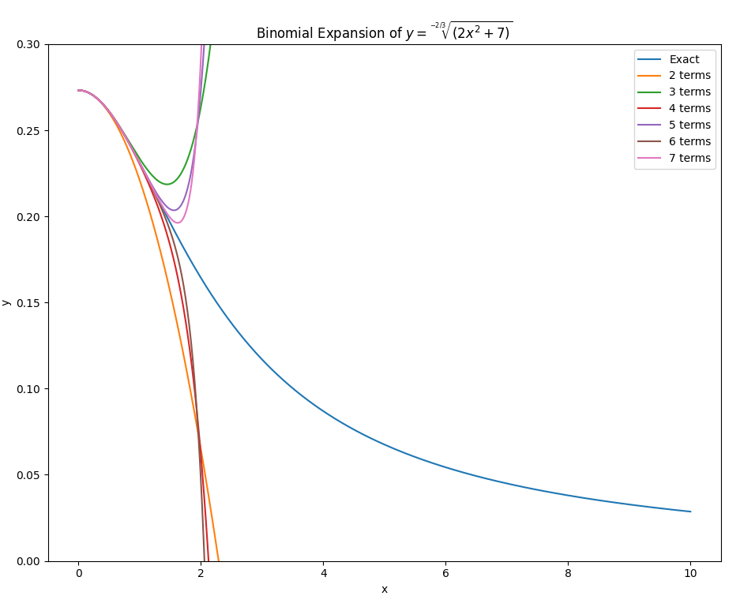
Run newton_binomial.py
These are the binomial expansions with successively more terms
Rate of Convergence to exact solution is very slow
This is the exact curve

Slide 16
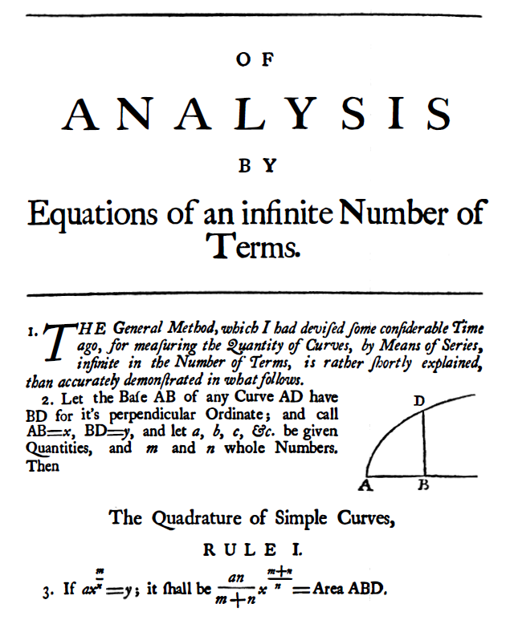
From Binomial Theorem to Calculus
Isaac Newton
1669
Salem Witch Trials
1693

Slide 17
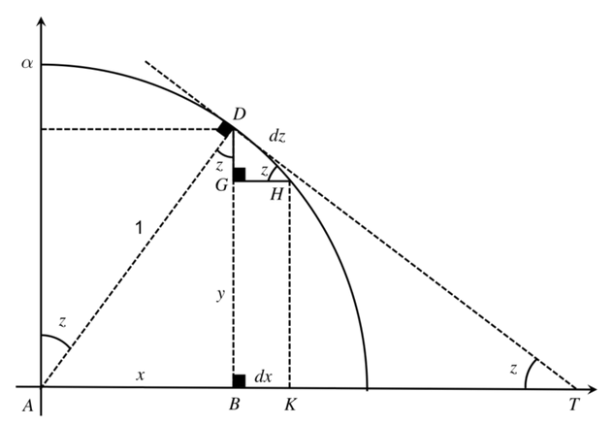
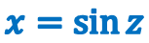
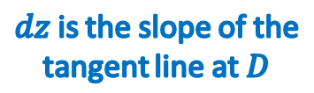
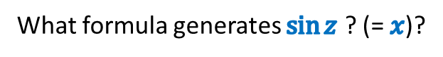
Newton's Sine Formula
What formula generates $\sin{z}$ ? (= $x$)?
$dz$ is the slope of the tangent line at $D$
$$x=\sin{z}$$

Slide 18
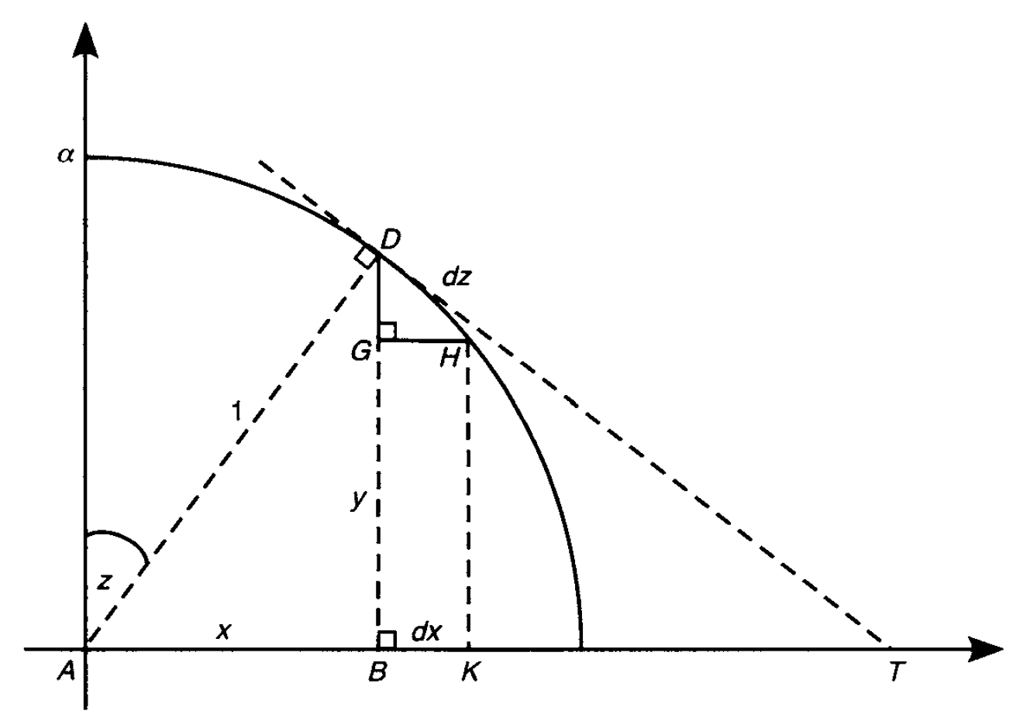
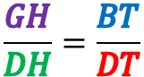
Newton's Sine Formula
Similar Triangles
$$\frac{GH}{DH}=\frac{BT}{DT}$$

Slide 19
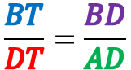
Newton's Sine Formula
Similar Triangles
$$\frac{BT}{DT}=\frac{BD}{AD}$$

Slide 20
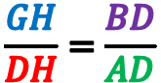
Newton's Sine Formula
Similar Triangles
$$\frac{GH}{DH}=\frac{BD}{AD}$$

Slide 21
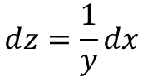
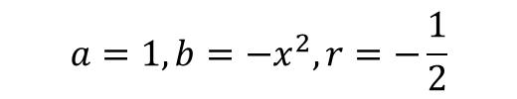
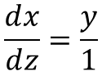
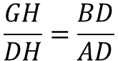
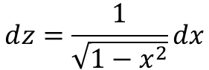
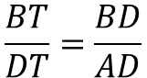
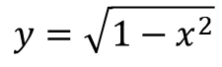


Newton's Sine Formula
Similar Triangles
$$\frac{GH}{DH}=\frac{BT}{DT}$$
$$\frac{BT}{DT}=\frac{BD}{AD}$$
$$\frac{GH}{DH}=\frac{BD}{AD}$$
$$\frac{ⅆx}{ⅆz}=\frac{y}{1}$$
Unit Circle
$$x^{2}+y^{2}=1$$
$$ⅆz=\frac{1}{y}dx$$
$$y=\sqrt{1−x^{2}}$$
$$ⅆz=\frac{1}{\sqrt{1−x^{2}}}dx$$
$$a=1,b=−x^{2},r=−\frac{1}{2}$$
$${\left(a+b\right)}^{r}=a^{r}+ra^{r−1}b+\frac{r(r−1)}{2!}a^{r−2}b^{2}+\frac{r(r−1)(r−2)}{3!}a^{r−3}b^{3}+⋯$$

Slide 22





Newton's Sine Formula
$${\left(a+b\right)}^{r}=a^{r}+ra^{r−1}b+\frac{r(r−1)}{2!}a^{r−2}b^{2}+\frac{r(r−1)(r−2)}{3!}a^{r−3}b^{3}+⋯$$
$$ⅆz=\frac{ⅆx}{\sqrt{1−x^{2}}}$$
$$a=1,b=−x^{2},r=−\frac{1}{2}$$
$$\frac{\left(−\frac{1}{2}\right)\left(−\frac{1}{2}−1\right)}{2!}=\frac{\left(\frac{3}{4}\right)}{2!}=\frac{3}{8}$$
$$ⅆz=\frac{1}{\sqrt{1−x^{2}}}dx=1+\frac{1}{2}x^{2}+\frac{3}{8}x^{4}+\frac{5}{18}x^{6}+\frac{35}{128}x^{8}⋯dx$$
$$z(x)=\int_{0}^{x}{\left(1+\frac{1}{2}x^{2}+\frac{3}{8}x^{4}+\frac{5}{18}x^{6}+\frac{35}{128}x^{8}⋯\right)ⅆx}$$
$$z(x)=x+\frac{1}{6}x^{3}+\frac{3}{40}x^{5}+\frac{5}{112}x^{7}+\frac{35}{1152}x^{9}⋯$$

Slide 23




Newton's Sine Formula
$$z(x)=x+\frac{1}{6}x^{3}+\frac{3}{40}x^{5}+\frac{5}{112}x^{7}+\frac{35}{1152}x^{9}⋯$$
$$arcsin(x)=x+\frac{1}{6}x^{3}+\frac{3}{40}x^{5}+\frac{5}{112}x^{7}+\frac{35}{1152}x^{9}⋯$$
$$x=sin\left(z\right)=z^{−1}(x)$$
$$z$$
How do we invert an infinite series?
How do we get $x$ in terms of $z$ ?
Remember, $∠z$ is the angle opposite side $x$ in $⊿ADB$ thus $\sin{z}=x$ therefore
$$z=arcsin\left(x\right)$$

Slide 24




Newton's Sine Formula
$$z(x)=x+\frac{1}{6}x^{3}+\frac{3}{40}x^{5}+\frac{5}{112}x^{7}+\frac{35}{1152}x^{9}⋯$$
$$arcsin(x)=x+\frac{1}{6}x^{3}+\frac{3}{40}x^{5}+\frac{5}{112}x^{7}+\frac{35}{1152}x^{9}⋯$$
$$\sin\left(x\right)=z^{−1}(x)$$
How do we invert an infinite series?
$$f\left(x\right)=Poly\left(x\right)−z=0$$
$$s=z$$
Expand $f(s+p)$, drop all $p^{2+}$ terms, solve for $p$
$t$ = Lowest power $z$ term in numerator
$$s=s+t$$

Slide 25




Newton's Sine Formula
$$z(x)=x+\frac{1}{6}x^{3}+\frac{3}{40}x^{5}+\frac{5}{112}x^{7}+\frac{35}{1152}x^{9}⋯$$
$$\left(z+p\right)+\frac{1}{6}{\left(z+p\right)}^{3}+\frac{3}{40}{\left(z+p\right)}^{5}+⋯−z=0$$
$$p=\frac{−\frac{1}{6}z^{3}−\frac{3}{40}z^{5}}{1+\frac{1}{2}z^{2}+\frac{3}{8}z^{4}}+⋯$$
$$t=−\frac{1}{6}z^{3}$$
$$f\left(x\right)=Poly\left(x\right)−z=0$$
$$s=z$$
$$s=z−\frac{1}{6}z^{3}$$
Expand $f(s+p)$, drop all $p^{2+}$ terms, solve for $p$
$t$ = Lowest power $z$ term in numerator
$$s=s+t$$

Slide 26




Newton's Sine Formula
$$z(x)=x+\frac{1}{6}x^{3}+\frac{3}{40}x^{5}+\frac{5}{112}x^{7}+\frac{35}{1152}x^{9}⋯$$
s
$$\left(z−\frac{1}{6}z^{3}+p\right)+\frac{1}{6}{\left(z−\frac{1}{6}z^{3}+p\right)}^{3}+\frac{3}{40}{\left(z−\frac{1}{6}z^{3}+p\right)}^{5}+⋯−z=0$$
$$p=\frac{\frac{1}{120}z^{5}−\frac{7}{144}z^{7}}{1+\frac{1}{2}z^{2}+\frac{5}{24}z^{4}}+⋯$$
$$t=\frac{1}{120}z^{5}$$
$$f\left(x\right)=Poly\left(x\right)−z=0$$
$$s=z$$
$$s=z−\frac{1}{6}z^{3}+\frac{1}{120}z^{5}$$
Expand $f(s+p)$, drop all $p^{2+}$ terms, solve for $p$
$t$ = Lowest power $z$ term in numerator
$$s=s+t$$

Slide 27



Newton's Sine Formula
$$z(x)=x+\frac{1}{6}x^{3}+\frac{3}{40}x^{5}+\frac{5}{112}x^{7}+\frac{35}{1152}x^{9}⋯$$
s
$$\left(z−\frac{1}{6}z^{3}+\frac{1}{120}z^{5}+p\right)+\frac{1}{6}{\left(z−\frac{1}{6}z^{3}+\frac{1}{120}z^{5}+p\right)}^{3}+\frac{3}{40}{\left(z−\frac{1}{6}z^{3}+\frac{1}{120}z^{5}+p\right)}^{5}+⋯−z=0$$
$$p=\frac{−\frac{1}{5040}z^{7}−\frac{157}{5184}z^{9}}{1+\frac{1}{2}z^{2}+\frac{5}{24}z^{4}}+⋯$$
$$t=−\frac{1}{5040}z^{7}$$
$$f\left(x\right)=Poly\left(x\right)−z=0$$
$$s=z$$
$$s=z−\frac{1}{6}z^{3}+\frac{1}{120}z^{5}−\frac{1}{5040}z^{7}$$
Expand $f(s+p)$, drop all $p^{2+}$ terms, solve for $p$
$t$ = Lowest power $z$ term in numerator
$$s=s+t$$

Slide 28



Newton's Sine Formula
$$z(x)=x+\frac{1}{6}x^{3}+\frac{3}{40}x^{5}+\frac{5}{112}x^{7}+\frac{35}{1152}x^{9}⋯$$
$$arcsin(x)=x+\frac{1}{6}x^{3}+\frac{3}{40}x^{5}+\frac{5}{112}x^{7}+\frac{35}{1152}x^{9}⋯$$
$$\sin\left(z\right)=z^{−1}(x)$$
$$z$$
How do we invert an infinite series?
$$x=sin\left(z\right)$$
$$\sin\left(z\right)=z−\frac{1}{6}z^{3}+\frac{1}{120}z^{5}−\frac{1}{5040}z^{7}+\frac{1}{362880}z^{9}+⋯$$
$$arcsin\left(x\right)=z$$

Slide 29




Newton's Sine Formula
$$\sin\left(θ\right)=θ−\frac{1}{6}θ^{3}+\frac{1}{120}θ^{5}−\frac{1}{5040}θ^{7}+\frac{1}{362880}θ^{9}+⋯$$
This 1st Derivative also checks out!
$$\cos\left(θ\right)=1−\frac{1}{2}θ^{2}+\frac{1}{24}θ^{4}−\frac{1}{720}θ^{6}+\frac{1}{40320}θ^{8}+⋯$$
$${\cos\left(θ\right)}^{′}=0−\frac{2}{2}θ+\frac{4}{24}θ^{3}−\frac{6}{720}θ^{5}+\frac{8}{40320}θ^{7}+⋯$$
$${\cos\left(θ\right)}^{′}=−θ+\frac{1}{6}θ^{3}−\frac{1}{120}θ^{5}+\frac{1}{5040}θ^{7}+⋯$$
$${\cos\left(θ\right)}^{′}=\left(−1\right)\left(θ−\frac{1}{6}θ^{3}+\frac{1}{120}θ^{5}−\frac{1}{5040}θ^{7}+⋯ \right)$$
Isaac Newton
(1643-1727)
$${\cos\left(θ\right)}^{′}=−\sin\left(θ\right)$$
☺

Slide 30

From the Binomial Theorem to Calculus
Isaac Newton (1669, age 26)

Slide 31

Taylor Series
https://www.youtube.com/watch?v=3d6DsjIBzJ4

Slide 32

Taylor Series
https://www.youtube.com/watch?v=3d6DsjIBzJ4

Slide 33

Taylor Series
https://www.youtube.com/watch?v=3d6DsjIBzJ4

Slide 34

Taylor Series
https://www.youtube.com/watch?v=3d6DsjIBzJ4

Slide 35

Taylor Series
https://www.youtube.com/watch?v=3d6DsjIBzJ4

Slide 36

Taylor Series
https://www.youtube.com/watch?v=3d6DsjIBzJ4

Slide 37

Taylor Series
https://www.youtube.com/watch?v=3d6DsjIBzJ4

Slide 38


Taylor Series
Brook Taylor
(1685-1731)
Integration by Parts

Slide 39



Taylor Series
$$\sin\left(θ\right)=\sum_{k=0}^{∞}{\frac{{\left(−1\right)}^{k}}{\left(2k+1\right)!}z^{2k+1}}$$
It is not obvious from these formulas that
$\frac{d}{dx}\sin{θ=\cos{θ}}$
Brook Taylor
(1685-1731)
$$\cos\left(θ\right)=\sum_{k=0}^{∞}{\frac{{\left(−1\right)}^{k}}{\left(2k\right)!}z^{2k}}$$
Generally, Taylor's Series will converge much faster than Newton's Binomial Expansion
Many physics derivations estimate an equation using a 3rd order Taylor Series – it is important to understand how this approximation is built!

Slide 40


Open taylor_series.py
①
②
Remove the "big-O" error estimate symbolic term
③
④
⑤
⑥
⑦
$$y_{n}=y_{n−1}+\left[f^{′}\left(x_{n−1}\right)\right]Δx$$
⑧

Slide 41

Run taylor_series.py
Even with an equal # of terms, the Taylor series still tracks closer than Newton's
With only five terms, the Taylor series begins to diverge
Euler's Method tracks longer than Taylor's series, but after 20 iterations, it too is no longer estimating well
This is the exact curve

Slide 42






Euler's Formula
$$\cos{θ}=1−\frac{θ^{2}}{2!}+\frac{θ}{4!}−\frac{θ^{6}}{6!}+\frac{θ^{8}}{8!}+…$$
$$\sin{θ}=θ−\frac{θ^{3}}{3!}+\frac{θ^{5}}{5!}−\frac{θ^{7}}{7!}+\frac{θ^{9}}{9!}+…$$
$$e^{x}=1+x+\frac{x^{2}}{2!}+\frac{x^{3}}{3!}+\frac{x^{4}}{4!}+\frac{x^{5}}{5!}+\frac{x^{6}}{6!}+\frac{x^{7}}{7!}…$$
$$e^{ix}=1+ix+\frac{{\left(ix\right)}^{2}}{2!}+\frac{{\left(ix\right)}^{3}}{3!}+\frac{{\left(ix\right)}^{4}}{4!}+\frac{{\left(ix\right)}^{5}}{5!}+\frac{{\left(ix\right)}^{6}}{6!}+\frac{{\left(ix\right)}^{7}}{7!}+…$$
$$e^{ix}=1+ix−\frac{x^{2}}{2!}−i\frac{x^{3}}{3!}+\frac{x^{4}}{4!}+i\frac{x^{5}}{5!}−\frac{x^{6}}{6!}−i\frac{x^{7}}{7!}+……$$
$$e^{iθ}=\left(1−\frac{θ^{2}}{2!}+\frac{θ^{4}}{4!}−\frac{θ^{6}}{6!}\right)+i\left(θ−\frac{θ^{3}}{3!}+\frac{θ^{5}}{5!}−\frac{θ^{7}}{7!}\right)+…$$
$$e^{iθ}=\cos{θ}+i\sin{θ}$$

Slide 43
All of Physics is Waves
Electrical
Magnetic
Acoustic
Heat Flow
Vibrational
Torsional
Nuclear / Quantum
Gravitational
Oceanic / Tidal
Orbital Precession
Springs
Pendulums
Tomography
Stock Market
Economics
Astronomical
Fluid Dynamics
Earthquakes
AC / DC
AM / FM
Speech
Heartbeats
It is really important that you develop a keen
understanding of the mathematics of waves!

Slide 44

Wave Types

Slide 45

Transverse Wave Components
Wavelength is across distance
Period
is across time

Slide 46












Transverse Wave Components
$$2π=\frac{radians}{cycle}$$
$$Angular velocity=ω=\frac{radians}{time}$$
$$ω=\left(\frac{radians}{cycle}\right)\left(\frac{cycle}{time}\right)$$
$$Period=T=\frac{time}{cycle}$$
$$ω=2πf$$
$$Frequency=f=\frac{cycle}{time}=\frac{1}{T}$$
$$Wave velocity=v=\frac{distance}{time}$$
$$Wavelength=λ=\frac{distance}{cycle}$$
$$v=\left(\frac{distance}{cycle}\right)\left(\frac{cycle}{time}\right)$$
$$Wavenumber=k=\frac{2π}{λ}$$
$$v=λf$$

Slide 47









Transverse Wave Components
$$y=\sin{x}$$
$$2π$$
$y=\sin{x}$ has a wavelength $λ=2π$
$$\frac{π}{2}$$
$$\frac{π}{2}+2π$$
$$sin\left(\frac{π}{2}\right){=1}$$
$$2π$$
Crest to Crest
1
0
$$\sin\left(\frac{π}{2}+2π\right)=\sin{\frac{π}{2}\cos{2π+\cos{\frac{π}{2}\sin{2π}}}=1}$$

Slide 48



Transverse Wave Components
$y=\sin{x}$ has a wavelength $λ=2π$
if k = 1
$$Wavenumber=k=\frac{2π}{λ}$$
$$y=\sin{kx}⇒λ=\frac{2π}{k}$$
Example: $λ=\frac{5 (distance)}{2 (crests)}⇒k=\frac{2π}{\left(\frac{5}{2}\right)}⇒k=\frac{4π}{5}⇒y=\sin{\frac{4π}{5}x}$

Slide 49

Known Wave Aliasing
Write Python code to display a graph of the function:
$$y={\left.\sin\left(\frac{4π}{5}x\right)\right|}_{0}^{20}$$
High-level approach:
Subdivide the specified domain into $n=640$ intervals
Calculate the range $y_{i}$ at each domain $x_{i}$ value
Store the domain and range values in NumPy arrays
Pass the two arrays to Matplotlib so it can draw a line graph connecting successive $\left(x_{i},y_{i}\right)$ points in the curve
2 crests per every 5 lengths

Slide 50




Open nyquist_known.ipynb
①
②
③
④
$$y={\left.\sin\left(\frac{4π}{5}x\right)\right|}_{0}^{20}$$
⑤
⑥

Slide 51



Run Cell 1 - nyquist_known.ipynb
$$\frac{20}{λ}=8 crests$$
$$λ=\frac{5}{2}=2.5$$

Slide 52


Run Cell 2 - nyquist_known.ipynb

Slide 53

Run Cell 3 - nyquist_known.ipynb

Slide 54


Run Cell 4 - nyquist_known.ipynb
What is the specific relationship between the sinusoid’s$λ$ and the graph’s $Δx$ that causes this catastrophic aliasing?
What happens with num_samples = 16 ?

Slide 55


Run Cell 5 - nyquist_known.ipynb
Does catastrophic aliasing occur for any value num_samples $≥$ 16 ?

Slide 56

Run Cell 6 - nyquist_known.ipynb
How can num_samples be chosen to avoid catastrophic aliasing ?

Slide 57


Run Cell 7 - nyquist_known.ipynb
At num_samples = 32 the graph is still coarse but at least now it reaches its full $±1$range

Slide 58


Nyquist Sampling Theorem
To minimize aliasing (data loss), if you know $λ$ ahead of time, set $n=\left(\frac{2}{λ}\right)\left(b−a\right)\left(2r\right), where r∈ℤ^{+}$
This rule is the Nyquist Sampling Theorem
You need at least 2x as many samples as the highest frequency you intend to capture
This wave is under sampled (n is too low!)

Slide 59


Unknown Wave Aliasing
You have an experiment that exhibits periodic behavior
How often (how many intervals $n$) would you sample the output to measure its wavelike nature?
Your hypothesis suggests a frequency of 210 so taking 420 samples should meet the Nyquist minimum

Slide 60

Run Cell 1 - nyquist_unknown.ipynb

Slide 61


Nyquist Sampling Theorem
Okay, we going to take 14x more samples!

Slide 62

Run Cell 2 - nyquist_unknown.ipynb
Even after taking so many samples (2940) we still have catastrophic aliasing!

Slide 63

Nyquist Sampling Theorem
What if we take one less sample?

Slide 64

Run Cell 3 - nyquist_unknown.ipynb
Taking one less sample made all the difference – why?
Now we can finally see the wave in its true form

Slide 65

Nyquist Sampling Theorem
If you don’t know (ahead of time) the $λ$ of a sampled sinusoid, then to minimize the chance of aliasing, is it best to set $n$ to a prime number $≥2×b$? Why?
What happens if by pure bad luck your sampling rate and the frequency of any of the constituent fundamental harmonics of the sampled wave are not coprime (GCD > 1)?
What happens if your sampling rate aligns somehow exactly to the oscillatory period of the sampled wave?
What can you do to ensure the GCD of two numbers has a higher probability of being equal to one (==1) ?

Slide 66

View Cell 3 - nyquist_unknown.ipynb
$$y=\sin\left(4πx\right)\sin\left(6πx\right)\sin\left(10πx\right)sin⁡(14πx)$$
Using a large prime number of samples helps avoid accidental aliasing if you don’t yet know the true nature of the underlying waveform

Slide 67
Travelling Waves & Superposition
$$λ=\frac{2π}{k}→k=\frac{2π}{λ}$$
$$y_{1}=A_{1}\sin\left(k_{1}x+ω_{1}t\right)$$
These waves have both spatial and temporal components
$$y_{2}=A_{2}\sin\left(k_{2}x+ω_{2}t\right)$$
$$f=\frac{ω}{2π}→ω=2πf$$
$$y_{1}+y_{2}= ?$$
$$y_{1}=A_{1}\sin\left(k_{1}x+ω_{1}t\right)=A_{1}\sin{k_{1}x}\cos{ω_{1}t}+A_{1}\cos{k_{1}x}\sin{ω_{1}t}$$
$$y_{2}=A_{2}\sin\left(k_{2}x+ω_{2}t\right)=A_{2}\sin{k_{2}x}\cos{ω_{2}t}+A_{2}\cos{k_{2}x}\sin{ω_{2}t}$$
Simple Case: $A_{1}=A_{2}=1,ω_{1}=ω_{2}=0$
1
$$y_{1}=\sin{k_{1}x}\cos{0t}+\cos{k_{1}x}\sin{0t}$$
1
$$y_{2}=\sin{k_{2}x}\cos{0t}+\cos{k_{2}x}\sin{0t}$$
$$y_{1}+y_{2}=\sin{k_{1}x}+\sin{k_{2}x}=2\sin\left(\frac{\left(k_{1}+k_{2}\right)x}{2}\right)\cos\left(\frac{\left(k_{1}−k_{2}\right)x}{2}\right)$$
SUM
PRODUCT

Slide 68


Travelling Waves & Superposition
But what if the two waves are oscillating at different angular velocities or have different amplitudes, or different wave numbers?

Slide 69






Open travelling_waves.ipynb
①
②
③
④
$$y_{1}=\sin\left(x+1/{16}t\right)$$
$$y_{2}=0$$
⑤
⑥
$$y_{3}=\frac{y_{1}+y_{2}}{2}$$
$$y_{1}=A_{1}\sin\left(k_{1}x+ω_{1}t\right)$$
$$y_{2}=A_{2}\sin\left(k_{2}x+ω_{2}t\right)$$

Slide 70

View Cell 1 - travelling_waves.ipynb
①
②
③
④
⑤
⑥
⑦
⑧
⑨

Slide 71

View Cell 1 - travelling_waves.ipynb
①
②
③
④
⑤
⑥
⑦
⑧
⑨
⑩

Slide 72


View Cell 1 - travelling_waves.ipynb
①
②
③
④
$$\frac{25ms}{frame}=\frac{40 frames}{sec}$$
⑤
⑥
⑦
⑧

Slide 73

Run Cell 1 - travelling_waves.ipynb

Slide 74


Run Cell 2 - travelling_waves.ipynb
Same $λ$ and $ω$, different amplitudes

Slide 75


Run Cell 3 - travelling_waves.ipynb
Different $λ$ but same $ω$and amplitudes

Slide 76


Run Cell 4 - travelling_waves.ipynb
Same amplitude and $λ$ but different $ω$

Slide 77


Run Cell 5 - travelling_waves.ipynb
Same amplitude and $λ$ but different (and now negative) $ω$

Slide 78


Run Cell 6 - travelling_waves.ipynb
Same $λ$ and amplitudes, and opposite $ω$

Slide 79




Run Cell 7 - travelling_waves.ipynb
The superposition of two waves, each having the
same amplitude and $λ$
but with an opposite $ω$,
produces a standing wave
$$y_{1}=\sin\left(x+1/{16}t\right)$$
$$y_{2}=\sin\left(x−1/{16}t\right)$$
What points are at the center of these circles?

Slide 80




Classic Wave Equation
$$υ=\frac{λ}{T}=\frac{{2π}/k}{{2π}/ω}=\frac{2π}{k}\frac{ω}{2π}=\frac{ω}{k}$$
$ν$ = wave phase speed
A forward travelling wave
$$y\left(x,t\right)=A\sin\left(kx−ωt\right)$$
$$\frac{∂y}{∂x}=Ak\cos\left(ωt−kx\right)$$
$$\frac{∂y}{∂t}=−Aω\cos\left(ωt−kx\right)$$
$$A\cos\left(ωt−kx\right)=\left(\frac{1}{k}\right)\frac{∂y}{∂x}$$
$$A\cos\left(ωt−kx\right)=\left(−\frac{1}{ω}\right)\frac{∂y}{∂t}$$
$$\frac{∂y}{∂x}=\left(−\frac{k}{ω}\right)\frac{∂y}{∂t}$$
$$\frac{∂y}{∂x}=\left(−\frac{1}{ν}\right)\frac{∂y}{∂t}$$

Slide 81
Classic Wave Equation
Does this differential equation hold for a wave travelling backwards?
$$\frac{∂y}{∂x}=\left(−\frac{1}{ν}\right)\frac{∂y}{∂t}$$
These equations don't match! ☹
$$y\left(x,t\right)=A\sin\left(kx+ωt\right)$$
$$\frac{∂y}{∂x}=Ak\cos\left(kx+ωt\right)$$
$$\frac{∂y}{∂t}=Aω\cos\left(kx+ωt\right)$$
$$A\cos\left(kx+ωt\right)=\left(\frac{1}{k}\right)\frac{∂y}{∂x}$$
$$A\cos\left(kx+ωt\right)=\left(\frac{1}{ω}\right)\frac{∂y}{∂t}$$
Because a standing wave is the superposition of two similar waves (one moving forward and one moving backward) we want a single differential equation that can describe both wave directions
$$\frac{∂y}{∂x}=\left(\frac{k}{ω}\right)\frac{∂y}{∂t}$$
$$\frac{∂y}{∂x}=\left(\frac{1}{ν}\right)\frac{∂y}{∂t}$$

Slide 82




Classic Wave Equation
What if we use the 2nd partial derivatives?
A forward travelling wave
$$y\left(x,t\right)=A\sin\left(kx−ωt\right)$$
$$\frac{∂^{2}y}{∂x^{2}}=Ak^{2}\sin\left(ωt−kx\right)$$
$$\frac{∂^{2}y}{∂t^{2}}=Aω^{2}\sin\left(ωt−kx\right)$$
$$A\sin\left(ωt−kx\right)=\left(\frac{1}{k^{2}}\right)\frac{∂^{2}y}{∂x^{2}}$$
$$A\sin\left(ωt−kx\right)=\left(\frac{1}{ω^{2}}\right)\frac{∂^{2}y}{∂t^{2}}$$
Because a standing wave is the superposition of two similar waves (one moving forward and one moving backward) we want a single differential equation that can describe both wave directions
$$\frac{∂^{2}y}{∂x^{2}}=\left(\frac{k^{2}}{ω^{2}}\right)\frac{∂^{2}y}{∂t^{2}}$$
$$\frac{∂^{2}y}{∂x^{2}}=\left(\frac{1}{ν^{2}}\right)\frac{∂^{2}y}{∂t^{2}}$$

Slide 83
Classic Wave Equation
Does this differential equation hold for a wave travelling backwards?
$$\frac{∂^{2}y}{∂x^{2}}=\left(\frac{1}{ν^{2}}\right)\frac{∂^{2}y}{∂t^{2}}$$
These equations match! ☺
$$y\left(x,t\right)=A\sin\left(kx+ωt\right)$$
$$\frac{∂^{2}y}{∂x^{2}}=−Ak^{2}\sin\left(kx+ωt\right)$$
$$\frac{∂^{2}y}{∂t^{2}}=−Aω^{2}w\sin\left(kx+ωt\right)$$
$$A\sin\left(kx+ωt\right)=\left(−\frac{1}{k^{2}}\right)\frac{∂^{2}y}{∂x^{2}}$$
$$A\sin\left(kx+ωt\right)=\left(−\frac{1}{ω^{2}}\right)\frac{∂^{2}y}{∂t^{2}}$$
Because a standing wave is the superposition of two similar waves (one moving forward and one moving backward) we want a single differential equation that can describe both wave directions
$$\frac{∂^{2}y}{∂x^{2}}=\left(\frac{k^{2}}{ω^{2}}\right)\frac{∂^{2}y}{∂t^{2}}$$
$$\frac{∂^{2}y}{∂x^{2}}=\left(\frac{1}{ν^{2}}\right)\frac{∂^{2}y}{∂t^{2}}$$

Slide 84

Classic Wave Equation
Because a standing wave is the superposition of two similar waves (one moving forward and one moving backward) we want a single differential equation that can describe both wave directions
$$\frac{∂^{2}y}{∂x^{2}}−\left(\frac{1}{ν^{2}}\right)\frac{∂^{2}y}{∂t^{2}}=0$$

Slide 85
PDEs Related to Wave Equation
$$\frac{∂y}{∂x}=\left(\frac{1}{ν}\right)\frac{∂y}{∂t}$$
Advection equation – A "one way" wave that describes dispersion over time
$$\frac{∂y}{∂t}−6y\left(x,t\right)\frac{∂y}{∂x}−\frac{∂^{3}y}{∂x^{3}}=0$$
Korteweg-de Vreis equation – Models solitary waves (solitons) where the solutions do not obey superposition
$$\frac{∂y}{∂t}=a\frac{∂^{2}y}{∂x^{2}}$$
Heat equation – Parabolic, so dissipative rather than oscillatory, exponential decay as a function of time
$$iℏ\frac{∂Ψ}{∂t}=\frac{−ℏ^{2}}{2m}\frac{∂^{2}Ψ}{∂x^{2}}+VΨ$$
Schrödinger equation – Oscillatory due to the complex wave function and it does not represent a physical location because it describes probability amplitudes

Slide 86




Mechanical Waves On a String
Total force
(T = tension) must balance, as the string does not break
String has uniform density $μ$
$$F_{y}=ma_{y}→a_{y}=\frac{F_{y}}{m}$$
Over a small displacement
$$m=μ$$
$$\frac{∂^{2}y}{∂t^{2}}=\frac{1}{μ}\left(T\left[\sin{θ_{2}−\sin{θ_{1}}}\right]\right)$$
Small Angle Identity
$$\frac{∂^{2}y}{∂t^{2}}=\frac{T}{μ}\left[\tan{θ_{2}−\tan{θ_{1}}}\right]$$
The string does not move in the
x-direction
$$\frac{∂^{2}y}{∂t^{2}}=\frac{T}{μ}Δ\left(\frac{dy}{dx}\right)$$
Tangent difference is the change in string’s slope over the displacement
$$\frac{∂^{2}y}{∂x^{2}}=\left(\frac{μ}{T}\right)\frac{∂^{2}y}{∂t^{2}}$$
Rewrite equation
$$v∝T$$

Slide 87
Finite Differences with Partial Derivatives
$$\frac{∂y}{∂x}=\frac{y\left(i+1,j\right)−y\left(i,j\right)}{Δx}$$
Centered on $\left(i+\frac{1}{2}\right)→$ Right
Location
$$\left(i\right)$$
Time
$$\left(j\right)$$
$$\frac{∂y}{∂x}=\frac{y\left(i,j\right)−y\left(i−1,j\right)}{Δx}$$
Centered on $\left(i−\frac{1}{2}\right)→$ Left
$$\frac{∂^{2}y}{∂x^{2}}=\frac{1}{Δx}\left[\frac{∂y}{∂x}\left(i+\frac{1}{2}\right)−\frac{∂y}{∂x}\left(i−\frac{1}{2}\right)\right]$$
$$\frac{∂^{2}y}{∂x^{2}}=\frac{1}{Δx}\left[\frac{y\left(i+1,j\right)−y\left(i,j\right)}{Δx}−\frac{y\left(i,j\right)−y\left(i−1,j\right)}{Δx}\right]$$
$$\frac{∂^{2}y}{∂x^{2}}=\frac{y\left(i+1,j\right)−2y(i,j)+y\left(i−1,j\right)}{{Δx}^{2}}$$

Slide 88
Finite Differences with Partial Derivatives
$$\frac{∂y}{∂t}=\frac{y\left(i,j+1\right)−y\left(i,j\right)}{Δt}$$
Centered on $\left(j+\frac{1}{2}\right)→$ Next
Location
$$\left(i\right)$$
Time
$$\left(j\right)$$
$$\frac{∂y}{∂t}=\frac{y\left(i,j\right)−y\left(i,j−1\right)}{Δt}$$
Centered on $\left(j−\frac{1}{2}\right)→$ Prior
$$\frac{∂^{2}y}{∂t^{2}}=\frac{1}{Δt}\left[\frac{∂y}{∂t}\left(j+\frac{1}{2}\right)−\frac{∂y}{∂t}\left(j−\frac{1}{2}\right)\right]$$
$$\frac{∂^{2}y}{∂t^{2}}=\frac{1}{Δt}\left[\frac{y\left(i,j+1\right)−y\left(i,j\right)}{Δt}−\frac{y\left(i,j\right)−y\left(i,j−1\right)}{Δt}\right]$$
$$\frac{∂^{2}y}{∂t^{2}}=\frac{y\left(i,j+1\right)−2y(i,j)+y\left(i,j−1\right)}{{Δt}^{2}}$$

Slide 89
Finite Differences with Partial Derivatives
$$\frac{∂^{2}y}{∂x^{2}}=\left(\frac{1}{ν^{2}}\right)\frac{∂^{2}y}{∂t^{2}}$$
Location
$$\left(i\right)$$
Time
$$\left(j\right)$$
$$\frac{∂^{2}y}{∂x^{2}}=\frac{y\left(i+1,j\right)−2y\left(i,j\right)+y\left(i−1,j\right)}{{Δx}^{2}}$$
$$ν^{2}\frac{∂^{2}y}{∂x^{2}}=\frac{∂^{2}y}{∂t^{2}}$$
$$\frac{∂^{2}y}{∂t^{2}}=\frac{y\left(i,j+1\right)−2y(i,j)+y\left(i,j−1\right)}{{Δt}^{2}}$$
$$ν^{2}\left[\frac{y\left(i+1,j\right)−2y\left(i,j\right)+y\left(i−1,j\right)}{{Δx}^{2}} \right]=\frac{y\left(i,j+1\right)−2y(i,j)+y\left(i,j−1\right)}{{Δt}^{2}}$$
$$\frac{v^{2}{Δt}^{2}}{{Δx}^{2}}\left[y\left(i+1,j\right)−2y\left(i,j\right)+y\left(i−1,j\right)\right]=y\left(i,j+1\right)−2y(i,j)+y\left(i,j−1\right)$$
$$r=\frac{ν^{2}{Δt}^{2}}{{Δx}^{2}}$$
$$r\left[y\left(i+1,j\right)−2y\left(i,j\right)+y\left(i−1,j\right)\right]=y\left(i,j+1\right)−2y(i,j)+y\left(i,j−1\right)$$
$$y\left(i,j+1\right)=2\left(1−r\right)y\left(i,j\right)+r\left[y\left(i+1,j\right)+y\left(i−1,j\right)\right]−y\left(i,j−1\right)$$

Slide 90
Finite Differences with Partial Derivatives
$$y\left(i,j+1\right)=2\left(1−r\right)y\left(i,j\right)+r\left[y\left(i+1,j\right)+y\left(i−1,j\right)\right]−y\left(i,j−1\right)$$
$$Assume r=1$$
Location
$$\left(i\right)$$
Time
$$\left(j\right)$$
$$y\left(i,j+1\right)=y\left(i−1,j\right)+y\left(i+1,j\right)−y\left(i,j−1\right)$$
Location (x) ⇨
0
1
2
3
4
← Index $\left(i=2\right)$
ya_prior $=\left(j−1\right)$
-
Time (t) ⇨
ya_current $=\left(j\right)$
+
c
+
ya_next $=\left(j+1\right)$
=

Slide 91

Open string_waves.ipynb
①
②
③
④
⑤
⑥
⑦

Slide 92

View string_waves.ipynb
①
Boundary Conditions
②
Boundary Conditions
③
④
⑤
⑥

Slide 93


Run Cell 1 - string_waves.ipynb
A Gaussian initial perturbation

Slide 94

Run Cell 2 - string_waves.ipynb
Reflected and
Inverted

Slide 95


Run Cell 3 - string_waves.ipynb
A 2nd Gaussian initial perturbation

Slide 96


Run Cell 4 - string_waves.ipynb
Complicated wave dynamics ensue

Slide 97

Electromagnetic Waves
$\vec{∇} ≡$ gradient (del) operator (nabla)
Divergence
$\vec{∇}∘\vec{E}=\frac{ρ}{ϵ_{0}}$
Gauss's Law for Electric Fields – Electric fields diverge from positive charges and converge on negative charges
$\vec{∇}∘\vec{B}=0$
Gauss's Law for Magnetic Fields – Magnetic Field lines only circulate, every source must have a sink
Curl
Faraday's Law – A changing magnetic field produces a circulating electric field
$\vec{∇}×\vec{E}=−\frac{∂\vec{B}}{∂t}$
Ampère-Maxwell Law – A circulating magnetic field is produced both by an electric current and a changing electric field
$\vec{∇}×\vec{B}=μ_{0}\vec{J}+μ_{0}ϵ_{0}\frac{∂\vec{E}}{∂t}$

Slide 98


Electromagnetic Waves
Take curl of Faraday's Law, then substitute in Ampère-Maxwell Law
$\vec{∇}×\left(\vec{∇}×\vec{E}\right)=−\frac{∂\left(\vec{∇}×\vec{B}\right)}{∂t}=−\frac{∂\left(μ_{0}\vec{J}+μ_{0}ϵ_{0}\frac{∂\vec{E}}{∂t}\right)}{∂t}$
$$\vec{v}=\vec{E}$$
This is a vector identity
$$\vec{∇}\left(\vec{∇}∘\vec{v}\right)−∇^{2}\vec{v}=\vec{∇}×\left(\vec{∇}×\vec{v}\right)$$
Laplacian
$$\vec{∇}\left(\vec{∇}∘\vec{E}\right)−∇^{2}\vec{E}=−μ_{0}\frac{∂\vec{J}}{∂t}−μ_{0}ϵ_{0}\frac{∂^{2}\vec{E}}{∂t^{2}}$$
Apply Vector Identity
Substitute in Gauss's Law for Electric Fields
$$\vec{∇}\left(\frac{ρ}{ϵ_{0}}\right)−∇^{2}\vec{E}=−μ_{0}\frac{∂\vec{J}}{∂t}−μ_{0}ϵ_{0}\frac{∂^{2}\vec{E}}{∂t^{2}}$$
In outer space,
$ρ=0$ and $\vec{J}=0$
$$∇^{2}\vec{E}=μ_{0}ϵ_{0}\frac{∂^{2}\vec{E}}{∂t^{2}}$$
Electric & Magnetic Fields propagate at same velocity
$$∇^{2}\vec{B}=μ_{0}ϵ_{0}\frac{∂^{2}\vec{B}}{∂t^{2}}$$
$$\frac{∂^{2}Ψ}{∂x^{2}}=μ_{0}ϵ_{0}\frac{∂^{2}Ψ}{∂t^{2}}$$

Slide 99







Electromagnetic Waves
$$\frac{∂^{2}Ψ}{∂x^{2}}=μ_{0}ϵ_{0}\frac{∂^{2}Ψ}{∂t^{2}}$$
$$\frac{∂^{2}y}{∂x^{2}}=\left(\frac{1}{ν^{2}}\right)\frac{∂^{2}y}{∂t^{2}}$$
James Clerk Maxwell
(1831-1879)
$$\frac{1}{ν^{2}}=μ_{0}ϵ_{0}$$
Oliver Heaviside
(1850-1925)
$$μ_{0}=Magnetic Field Permeability$$
$$v=\sqrt{\frac{1}{μ_{0}ϵ_{0}}}$$
$$μ_{0}=1.2566371×{10}^{−6} H/m^{2}$$
$$ϵ_{0}=\text{Electric} \text{Field} \text{Permittivity}$$
$$ϵ_{0}=8.8541878×{10}^{−12} F/m$$
To travel faster than $3×{10}^{8}$, simply reduce $μ_{0}$ or $ϵ_{0}$ ☺
$ν=2.9979×{10}^{8} m/s=c$ (Speed of Light)

Slide 100

Session 12 – Now You Know…
Nyquist Sampling Theorem – to minimize aliasing (data loss):
Known wave (you know $λ$) set $n=\frac{b}{λ}r, where r∈ℤ^{+}and r≥2$
That you need at least 2x as many samples as the highest frequency you want to capture is the essence of the Nyquist Theorem
With an unknown wave (you don’t know $λ$) take a prime number of samples $\left(≥2×b\right)$ to minimize the chance of aliasing
The superposition of two travelling waves, having the same wavelength but opposite angular frequency, produces a standing wave
A standing wave still oscillates but does not travel (the location of the nodes remains constant)
Superposition is a crucial concept in quantum mechanics!

Slide 101
Session 12 – Now You Know…
The Classical Wave Equation is a 2nd order PDE in both space and time, and works for waves moving in either direction
We can use the method of Finite Differences to numerically estimate Partial Differential Equations
Electromagnetic fields propagate as a classical wave equation – the speed of light is governed by the universal constants for vacuum permittivity and permeability

Slide 102

Task 12-01
Create a Jupyter Lab notebook named agnesi_witch.ipynb
Express Maria Agnesi's "witch" as a function $f(x)$ using the simplified equation where $a=1/2$
Express $f\left(x\right)$ as a power series over $−1<x<1$
On a single graph, plot the exact value of $f\left(x\right)$ and successively more (from 2 to 7) terms of its power series from $−1.5<x<1.5$
The plots should visibly demonstrate that high-degree polynomial interpolation at equidistant points can be problematic because adding more terms does not always result in improved accuracy

Slide 103

Task 12-01 (cont.)
As we include more terms in a power series approximation for a function, it is supposed to get better (it should more closely follow the exact curve) but in this case, adding more terms doesn't seem to be helping…

Slide 104

Task 12-01 (cont.)
Typically, as we add more terms to a power series, our estimate becomes closer and closer to the exact value, however at the endpoints of the interval this power series behaves poorly
Consider expanding the domain to include $ℂ$ such as $x=−i$ or $x=i$, what happens at those points?
Append a final cell in your notebook that contains (as comment lines) a short explanation (in prose) of:
Why Agnesi’s Witch quickly diverges (as we add more terms to the power series) as we approach $x=−1$ or $x=1$
How this simplified witch function demonstrates Runge's Phenomenon
Upload your solution to the BNL QIS101 SharePoint site

Slide 105

Task 12-02
Create a Python file named werner_formula.py
Using pyplot, on one graph plot four functions over the domain $−3π≤x≤3π$
$f_{1}\left(x\right)=\sin\left(0.8x\right)$
$f_{2}\left(x\right)=\sin\left(0.5x\right)$
$f_{3}\left(x\right)=f_{1}\left(x\right)∗f_{2}\left(x\right)$
$f_{4}\left(x\right)=$ Werner's Product-to-sum formula for $f_{1}\left(x\right)∗f_{2}\left(x\right)$
Plot $f_{4}\left(x\right)$ as a dotted line with open circle markers
Use LaTeX encoding to populate the legend labels for each curve
Upload your solution to the BNL QIS101 SharePoint site

